Slide 1
Big Mountain Resort
Recommendations on Pricing and Facilities

Slide 2
Goal: Increase the Resort’s revenue and decrease costs by $1.54 million over next season.
Big Mountain Resort is failing to capitalize on its features and position in the market.
Tickets are underpriced
Facilities are not arranged optimally
Market strategy is not data-driven

Slide 3
We recommend that Big Mountain Resort increase adult weekend ticket price to $85 and close its least used run.
Big Mountain has valuable qualities (high vertical drop, snow making acres, chairs, runs) that justify a higher price.
Closing the least used run would make no difference in ticket price or revenue.

Slide 4
Modeling Results and Analysis
We modeled adult weekend ticket price with a train/test split of 70%/30%. We tried predicting ticket price with:
The mean of the training set
Mean absolute error over $19
Linear Regression model
Used median to impute missing values, scaled data
Used optimal number of features (8) to avoid overfitting
Mean absolute error less than $9.50
Random Forest Regressor model
Used median to impute missing values, no scaling required
Even lower mean absolute error than linear model (by almost $1)
Less variability than linear model

Slide 5
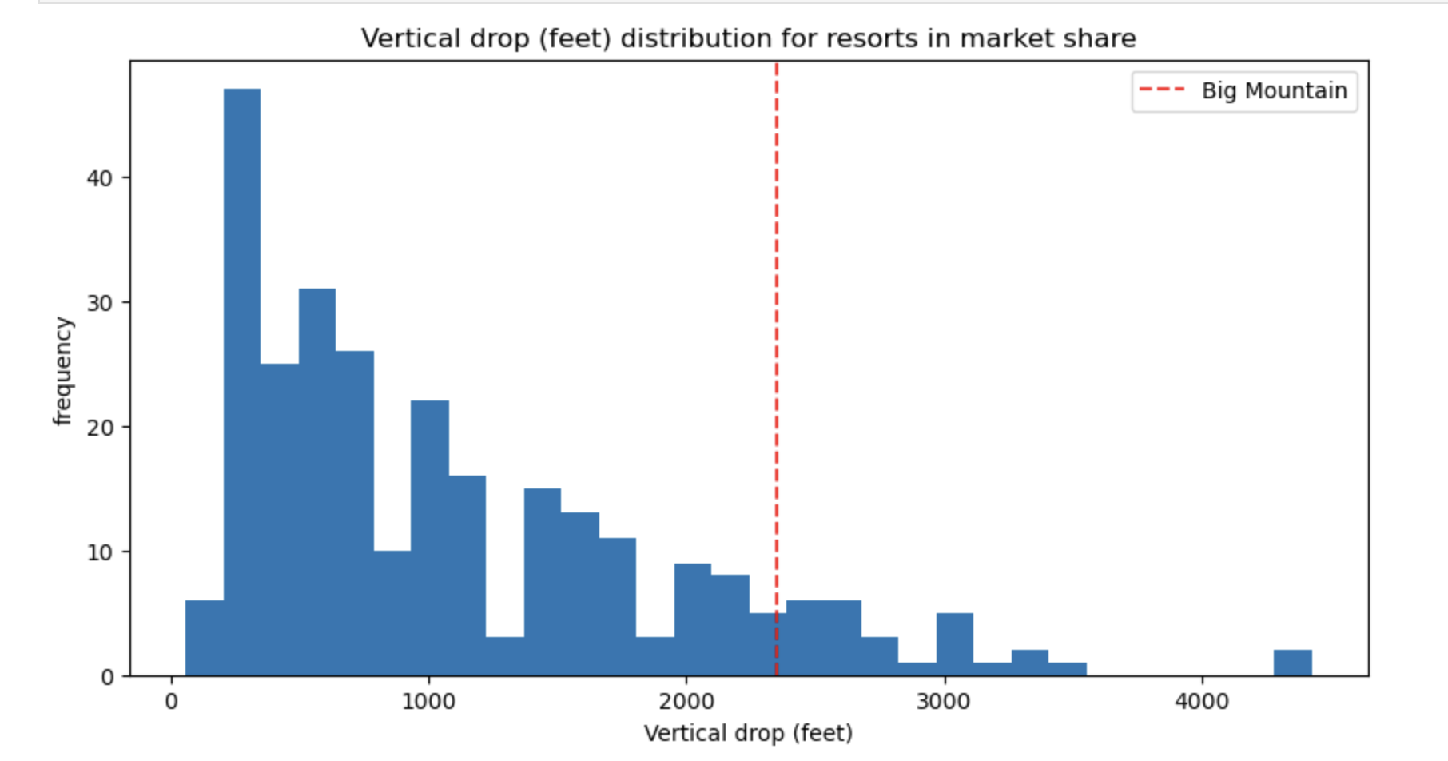
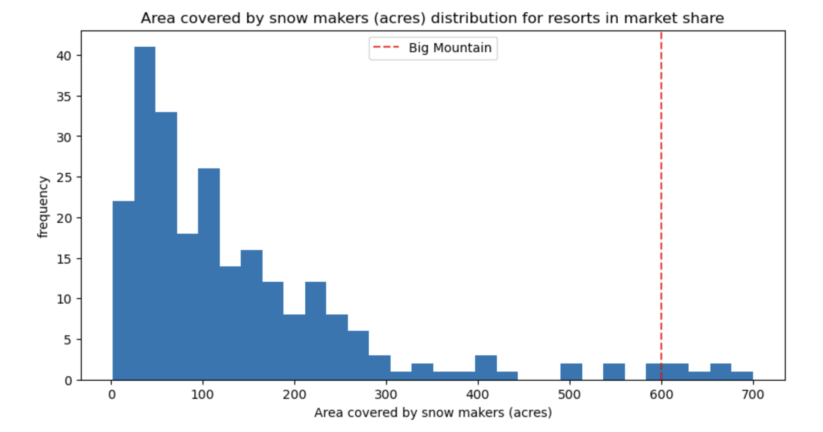
Modeling results and analysis
Our Random Forest model predicted an adult weekend ticket price of $95.87 with a range of error of $10.39 for Big Mountain Resort.
Accordingly, the most conservative estimate for Big Mountain’s ticket price is $85.00.
Big Mountain is performing well in these areas important to the market: vertical drop and snow making acreage.

Slide 6
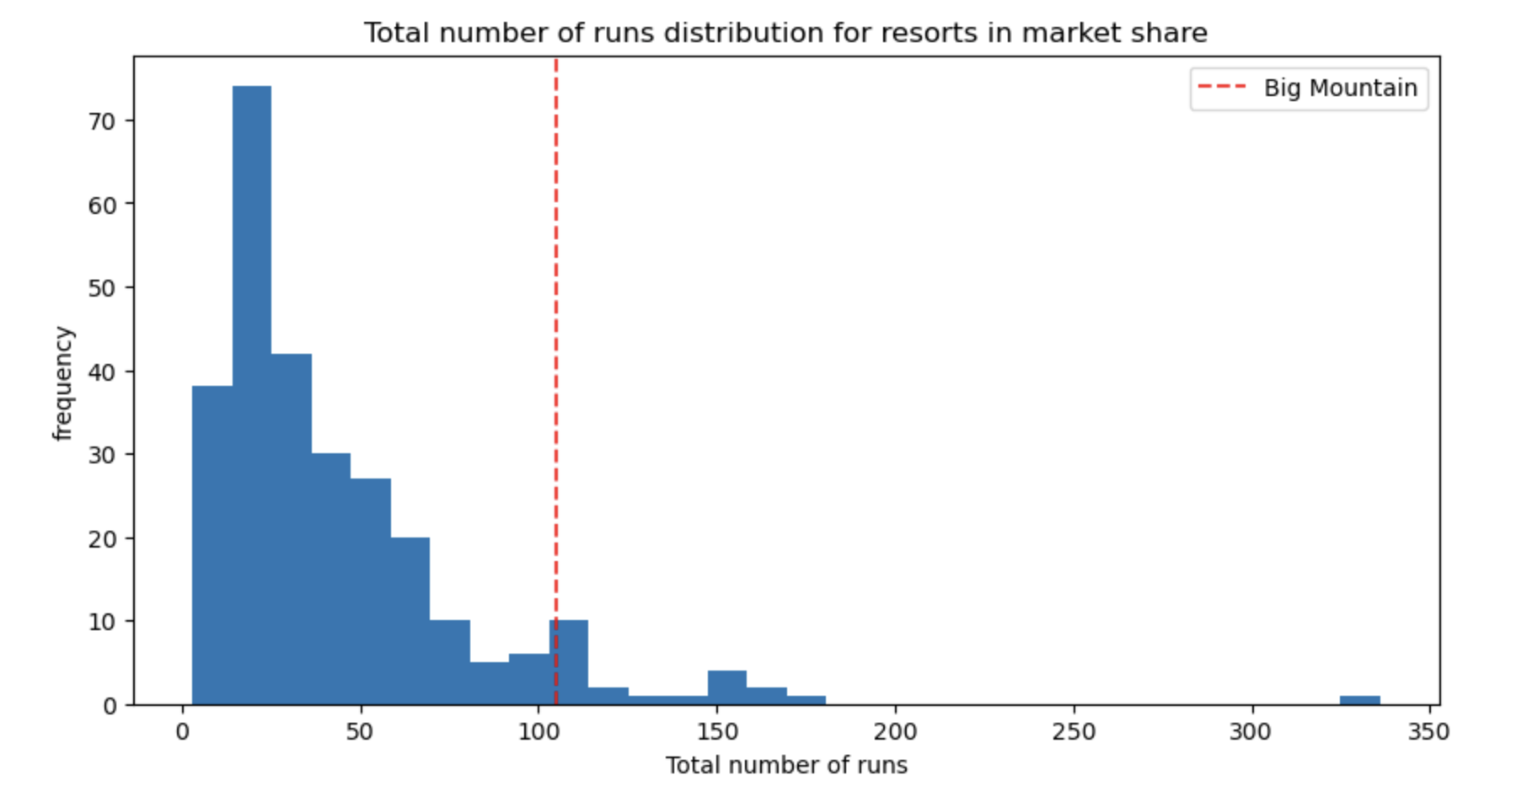
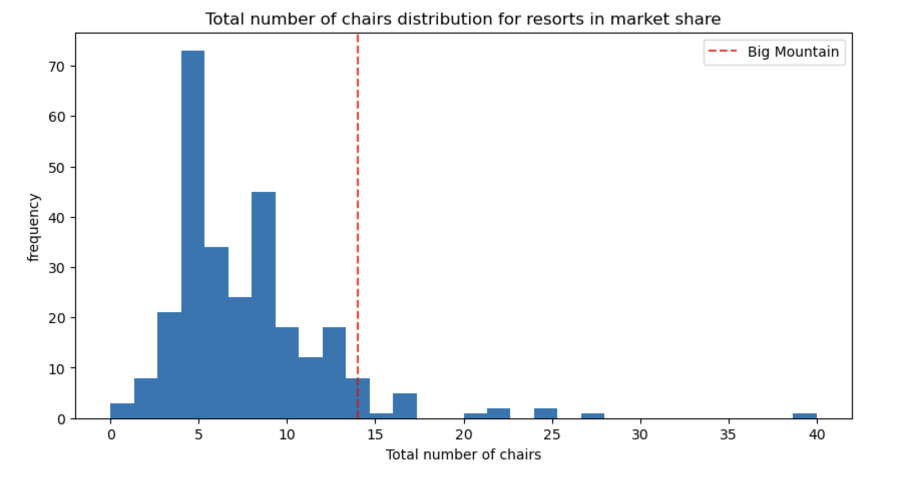
Modeling results and analysis
Big Mountain is performing well in these areas important to the market: total chairs and total runs.
Big Mountain also has other features that appeal strongly to customers that are not shown in these graphs, such as a high summit, large amount of skiable terrain, and fast quads.
Our model’s prediction of a higher ticket price is not surprising given these qualities.

Slide 7
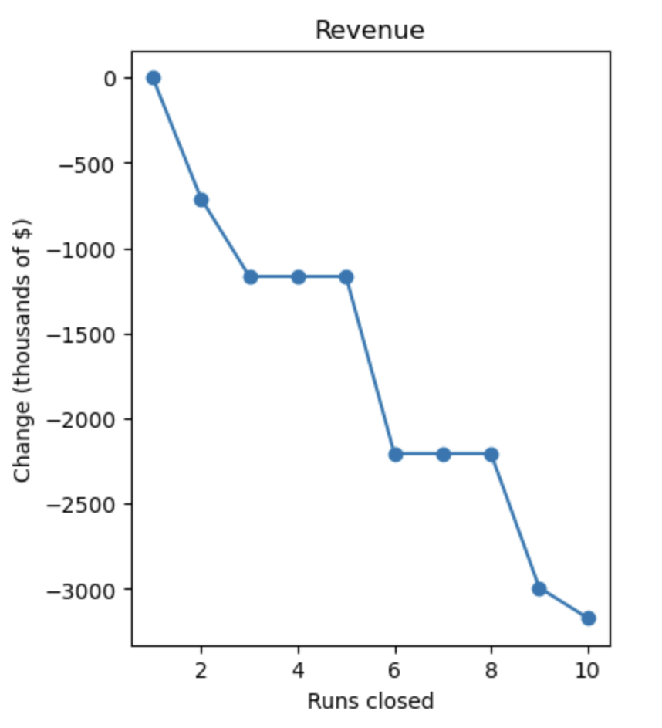
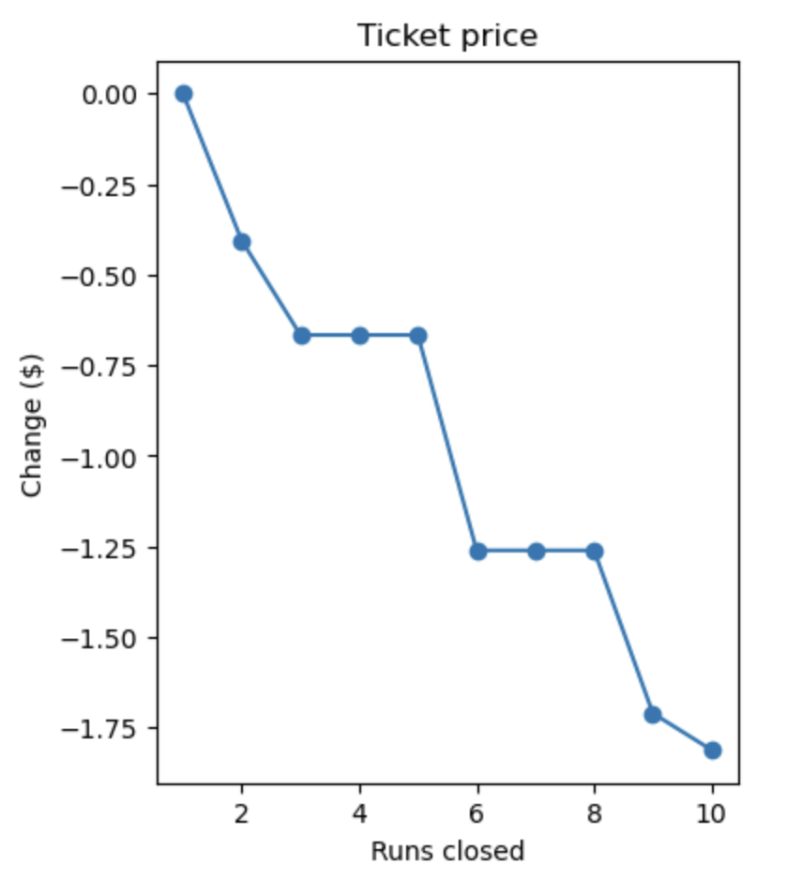
Modeling Results and Analysis
Our model also shows that closing one run would not reduce support for ticket price, so we recommend that Big Mountain close its least used run.
Optional scenarios:
Close 2 - 5 runs depending on operating costs saved.
Increase vertical drop by adding a strategically placed run and new chair lift. This would justify increasing ticket price by an additional $1.99.

Slide 8
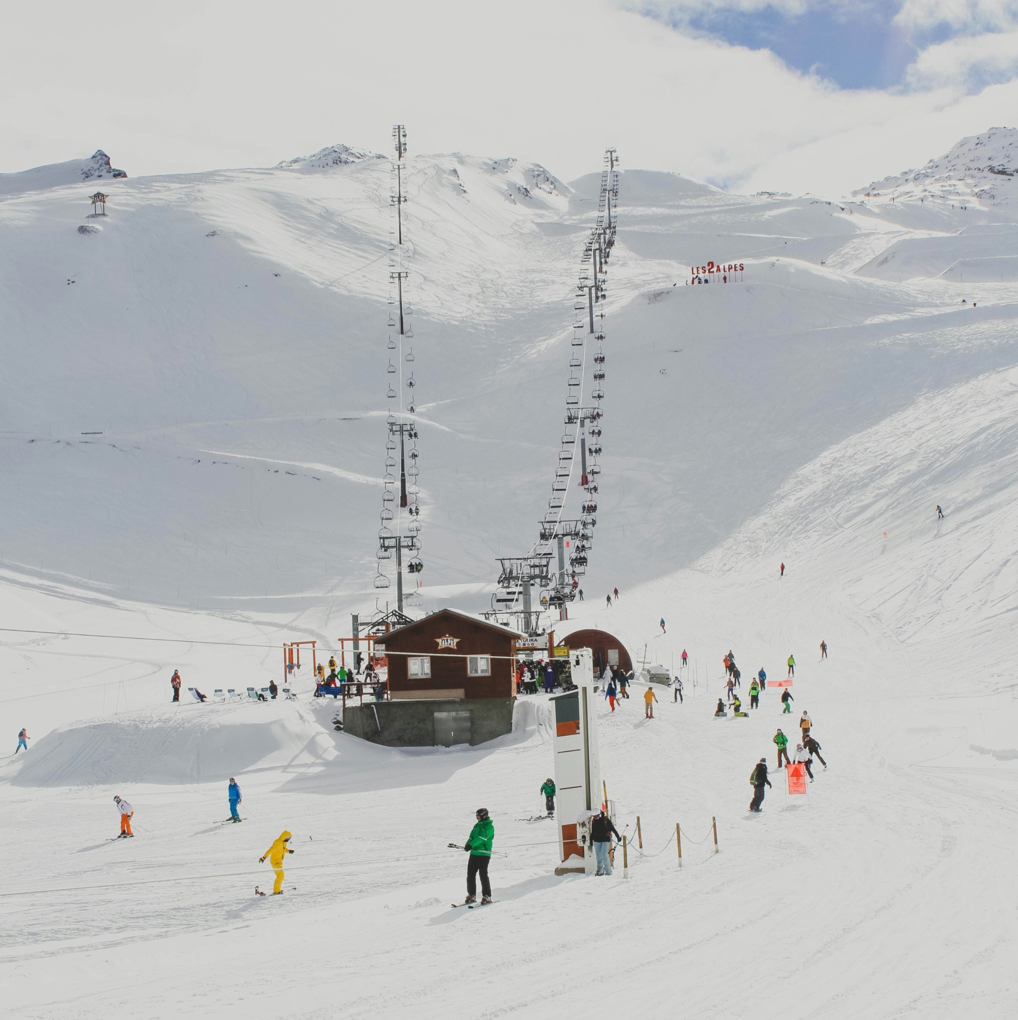
Summary
Increase adult weekend ticket price to $85.
Close least used run.
Consider optional scenarios.
Thanks and best wishes for next season!

